Slide 1
Intelligent Object Detection and Analytics Dashboard
Name: Syed Muhammed Zahi
Department: B.Tech Artificial intelligence and Data Science
College Name: Saveetha Engineering College
E Mail ID: oisci0353@gmail.com
Mobile No: 6374649776
Register No: 212221230114

Slide 2

Abstract
This project focuses on developing an intelligent dashboard that integrates object detection with video analytics, providing comprehensive insights through visualizations. Using advanced Python libraries such as OpenCV, Pandas, Matplotlib, and Seaborn, the system efficiently processes video data to detect objects, track their frequencies over frames, and display the results in an interactive Streamlit dashboard. Designed for scalability and real-world applications, this project serves as a powerful tool for industries requiring dynamic data-driven insights, such as retail, surveillance, and traffic monitoring.

Slide 3
PoV - Analysis
1. Stakeholder Perspective:
Students: As a student project, it demonstrates the ability to integrate data analytics and visualization to solve real-world problems effectively.
Academicians: It showcases the practical implementation of theoretical concepts like object detection and data analytics, making it an excellent example for teaching.
2. Project Objectives:
To develop a user-friendly dashboard for real-time video analytics.
To enable actionable insights through effective data visualizations.
3. Technical Analysis:
Efficiency: The project processes frame-level object detection efficiently and organizes results for intuitive understanding.
Scalability: The project design can be extended for more complex datasets, making it versatile.
User Interaction: Built with Streamlit, it provides a professional and interactive user interface.
4. Impact Statement:
This project is a stepping stone in bridging the gap between raw video data and meaningful insights, demonstrating how video analytics can be harnessed for advanced, real-time decision-making in a professional setting.

Slide 4
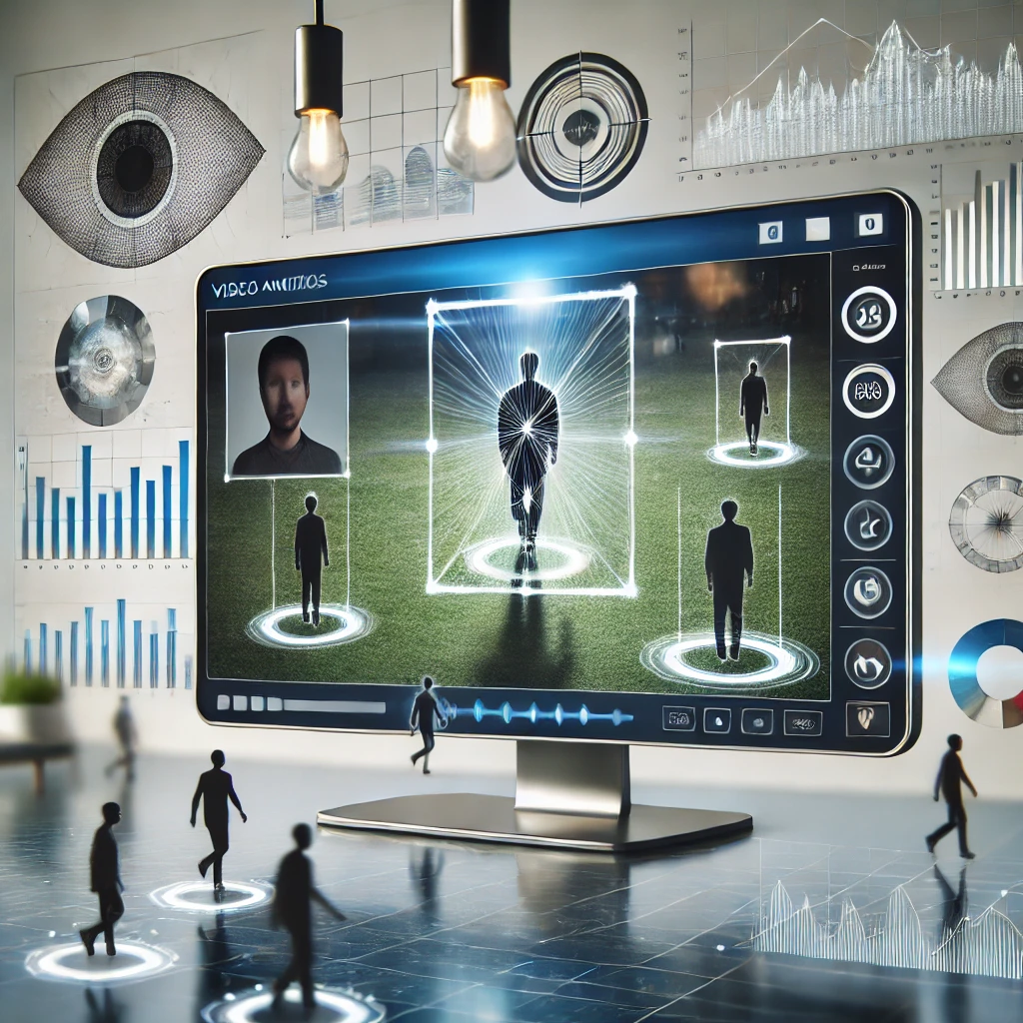
Project Description
The "Interactive Video Analytics Dashboard for Object Detection" is a data-driven project aimed at processing video footage to extract actionable insights through object detection and analysis. Utilizing Python libraries such as OpenCV, Pandas, and Seaborn, the project processes video frames to identify objects, their frequency, and spatial positions. The results are dynamically visualized in a user-friendly Streamlit dashboard, enabling intuitive understanding of the data. With applications in fields like retail analytics, traffic management, and surveillance, this project demonstrates the power of video analytics in transforming raw data into meaningful insights, paving the way for advanced real-time decision-making.

Slide 5

Problem Definition
The main challenge addressed by this project is the real-time monitoring and analysis of objects detected in video streams. With the increasing demand for automated surveillance, retail analytics, and smart systems, understanding object detection trends across frames is critical. However, current systems often lack:
Real-time Data Visualization: An easy-to-understand interface to track detection frequencies and object insights over time.
Efficient Data Insights: Tools to analyze and interpret the collected object detection data effectively.
Scalability: A framework that adapts to different use cases, such as retail footfall analysis, traffic monitoring, or surveillance enhancement.
This project focuses on solving these gaps by building a dashboard that visualizes object detection trends across video frames. It provides insights into detection frequency, object types, and their positions within the video stream, enabling actionable decision-making.

Slide 6
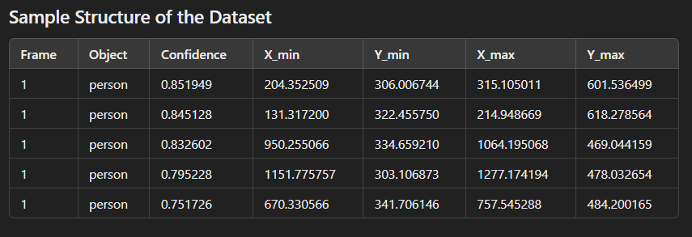
Input file - data set
The input file for this project is a dataset containing video analysis results extracted from object detection processes. This data is structured to include information about detected objects across multiple video frames, providing essential details for visualization and analytics.

Slide 7
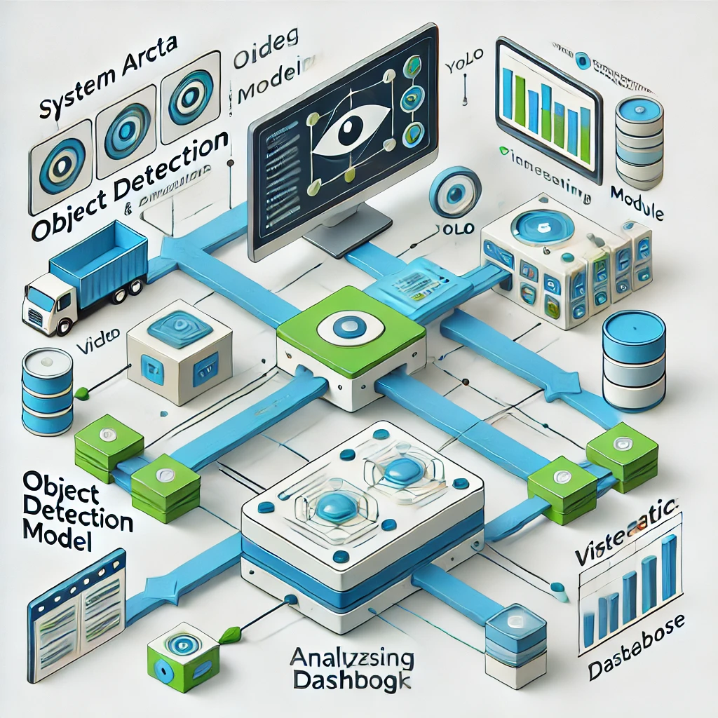
System Architecture

Slide 8
Algorithm
Input Preparation: Extract frames from a video using OpenCV.
Object Detection: Use a pre-trained model (e.g., YOLO) to identify objects in each frame and record their details (coordinates, confidence, type).
Data Storage: Save the detection results into a CSV file for easy access.
Visualization: Develop a Stream lit dashboard with:
Detection frequency plots.
Frame previews with bounding boxes.
Interactivity: Enable users to filter and analyze data dynamically within the dashboard.
Testing and Optimization: Validate with sample datasets and refine for better performance.
Future Scope: Add real-time processing and advanced analytics.

Slide 9
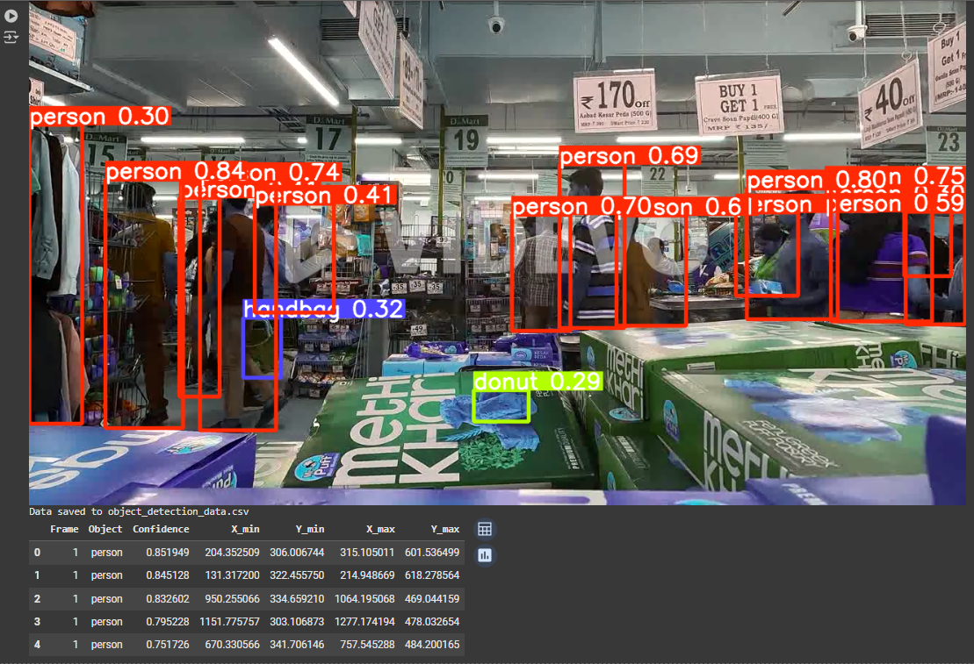
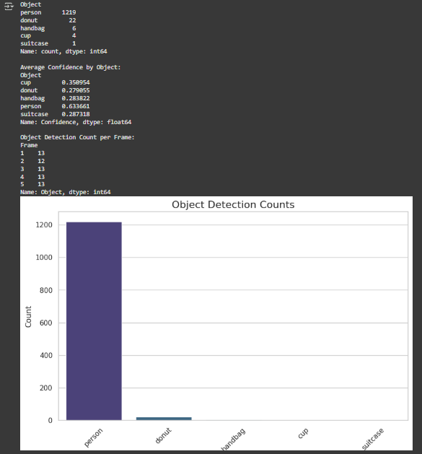
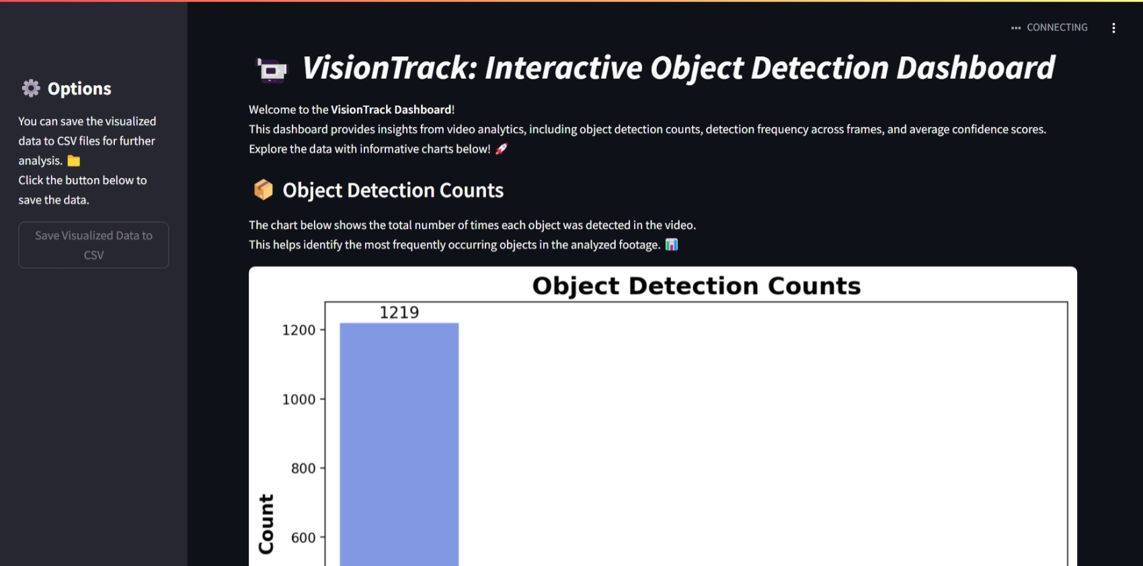
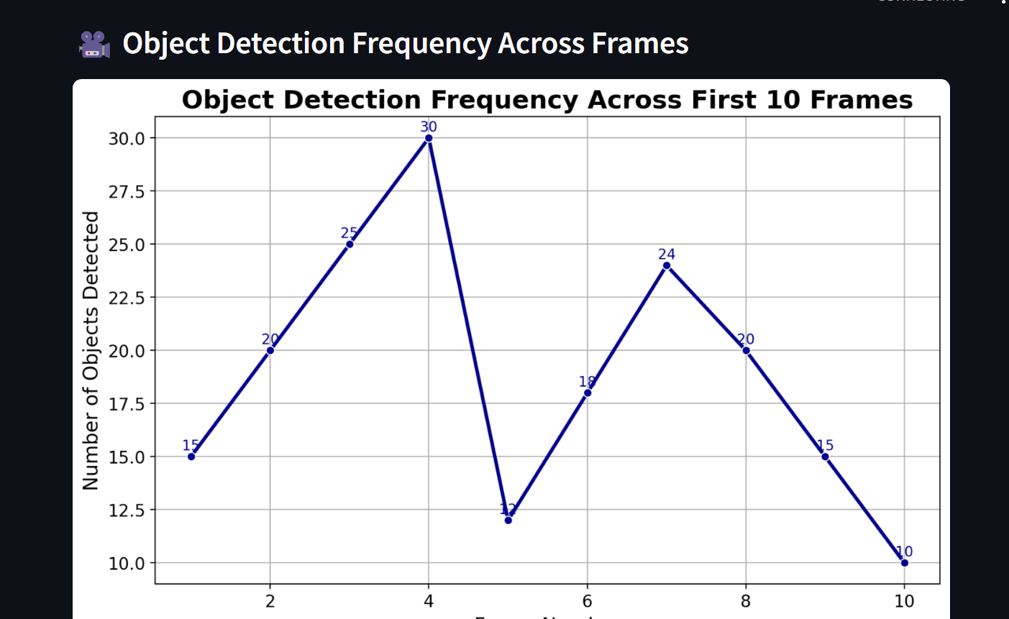
Output of the Project

Slide 10

Conclusion
The "Interactive Video Data Analysis Dashboard" is a testament to the powerful integration of computer vision and data analytics. By combining cutting-edge object detection algorithms with an intuitive visualization interface, this project empowers users to extract actionable insights from video data efficiently.
Through the streamlined data pipeline, from video preprocessing to interactive dashboards, the project showcases the potential for real-time decision-making in various domains such as surveillance, retail analytics, and autonomous systems. The system's ability to provide clear and meaningful insights ensures its relevance and adaptability to diverse applications.
This project lays a robust foundation for future advancements, including the integration of predictive analytics and the expansion of multi-object tracking capabilities, opening new horizons for innovation and practical utility.

